Slide 1
Cloud foundations for sustainable scale
CLIENT STRATEGY · 2026
Example title slide — replace with your own presentation title
Month 2026 · Prepared for: Example audience
Notes:
Title slide (layout: Aashvi Oy Title). Keep the title under ~8 words, sentence case, no full stop. The eyebrow is uppercase and short. Use the meta line for date and audience. Never put a real client name here before it is approved.

Slide 2
Agenda
01
Context
Where the platform is today and what is changing
02
Options
Three paths, compared on risk, cost and maintainability
03
Recommendation
The path we propose and why
04
Next steps
Decisions needed and a 90-day plan
Notes:
Agenda on the Title Only layout. Up to five items; numbers in Engineering Blue, titles bold, one-line details in muted text.

Slide 3
Context
01
What the current platform does well, and where it slows the business down
Notes:
Section divider (layout: Aashvi Oy Section). Use one per major part of the story.

Slide 4
Where we are, and where we are going
Today
Manual environment set-up per release
Ownership of services is unclear
Incidents are found by customers first
Target state
Reproducible environments from code
Every service has a named owner
Observability that alerts before users notice
Notes:
Two Column layout for comparisons (before/after, options, pros/cons). Example content — replace it.

Slide 5
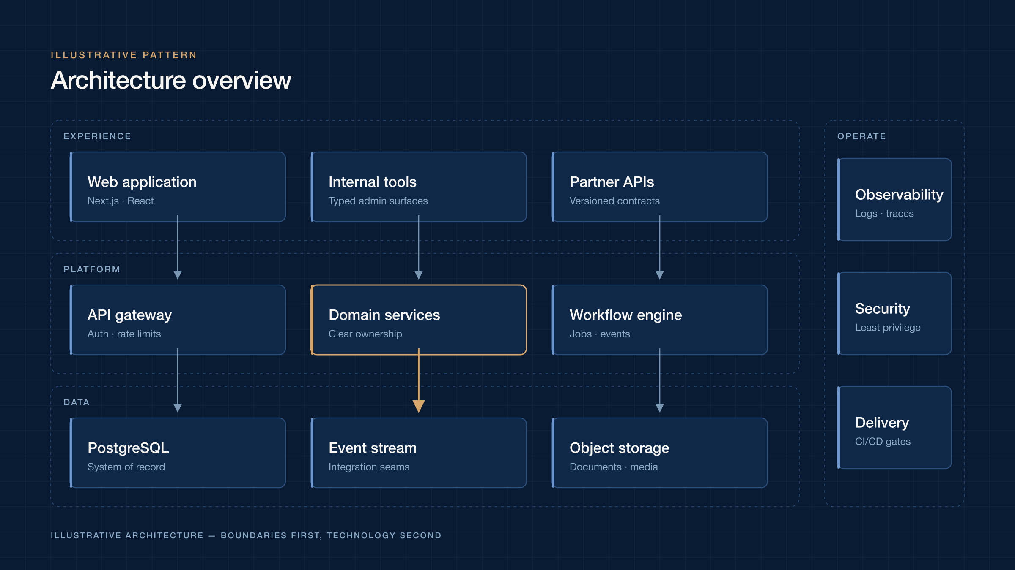
Boundaries first, technology second
Clear layers keep change local: experience, platform and data evolve independently.
Operations — observability, security and delivery — run alongside every layer.
Illustrative architecture pattern
Notes:
Text and Image layout. Use the dark diagrams from the brand resources page; always caption illustrative material.

Slide 6
How we work
01
02
03
Precise
Assured
Human
Make complexity legible. Exact language, disciplined layouts and evidence-led claims.
Quiet confidence. The work should feel dependable, never loud.
Technology serves people. Be direct, generous and clear about what changes.
Notes:
Three-up cards on Warm Ivory. Good for principles, options or phases.

Slide 7
Lead time falls as delivery is automated
Illustrative data
Replace with verified figures. Never publish client metrics without approval.
Notes:
Native PowerPoint chart (edit data via right-click › Edit Data). One series in Engineering Blue; use copper only to highlight a single bar.

Slide 8
A 90-day plan
Phase | Weeks | Outcome
Discover | 1–2 | Shared map of systems, risks and owners
Design | 3–4 | Target architecture and migration path agreed
Build | 5–10 | First workloads running on the new foundation
Operate | 11–13 | Runbooks, alerts and handover to the team
Notes:
Tables: navy header row, hairline borders, generous row height. Keep to ~6 rows per slide.

Slide 9
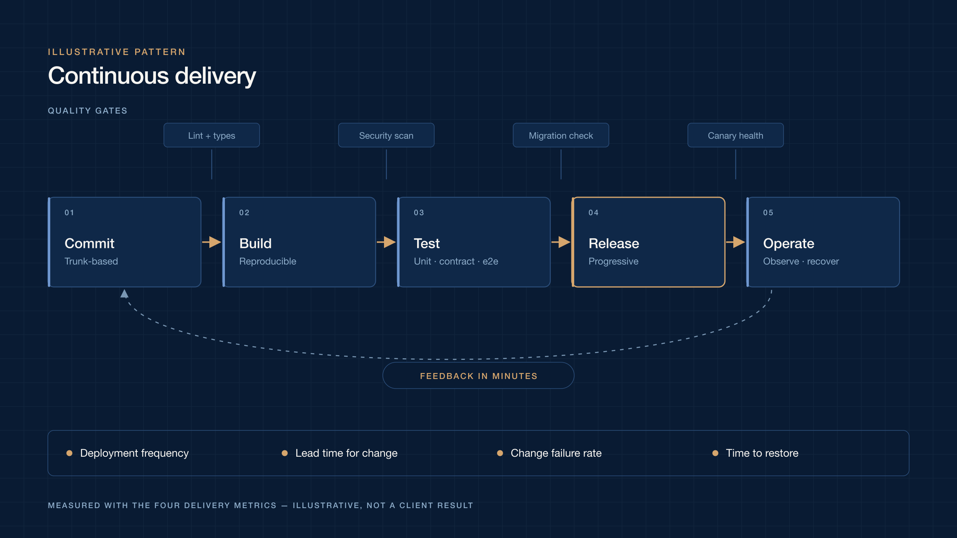
Continuous delivery, end to end
Notes:
Title Only Dark: use for dark diagrams so they sit flush on Midnight Navy.

Slide 10
Engineering clarity into complex systems.
Aashvi Oy — brand promise
Notes:
Statement layout for one key message or a short quote. Attribute quotes; never invent testimonials.

Slide 11
Thank you
Next step: agree the scope of the discovery phase
Notes:
Closing layout. Point to a concrete next step. Contact goes through aashvi.net — do not add personal email addresses to shared decks.

